Slide 1
03 | Querying models
Susan Ibach | Senior Technical Evangelist
Christopher Harrison | Senior Content Developer

Slide 2
Module Overview
Creating and updating data
Basic queries
Custom queries

Slide 3
Creating and updating data

Slide 4
If you know how to create an object in Python…
You already know how to create and save objects into the database using Django
The save method was added when we specified our class inherited from Model
newArtist = Artist(name = 'Artist Name', year_formed = 2015);
newArtist.save();
Notes:
Create an artist using the Django Shell in Visual Studio
Switch back to Visual Studio
Right click on the project, and choose Python > Open Django Shell
This will load all of the necessary libraries
This is possible from the command prompt, but doing it this way makes it easier
Create the artist
In the shell type:
from app.models import Artist;
newArtist = Artist(name = "The Cure", year_formed = 1978);
newArtist.save();
This will create the artist and save it in the SQLite database

Slide 5
And if you know how to modify objects in Python…
You know how to update the object in the database
The Python ORM automatically tracks changes to the object
All you need to do is update the object, and call save()
newArtist.name = 'Updated Name';
newArtist.save();

Slide 6
Creating and saving objects using Django ORM
Notes:
Create an artist using the Django Shell in Visual Studio
Switch back to Visual Studio
Right click on the project, and choose Python > Open Django Shell
This will load all of the necessary libraries
This is possible from the command prompt, but doing it this way makes it easier
Create the artist
In the shell type:
from app.models import Artist;
newArtist = Artist(name = "The Cure", year_formed = 1978);
newArtist.save();
This will create the artist and save it in the SQLite database
Now update the year formed and save the changes
newArtist.year_formed=1986
newArtist.save()

Slide 7
Basic Queries

Slide 8
Django has great support for querying data
Basically, however you need to go get the data there's a way to write the query using Django ORM
Queries are created by using the objects collection
objects is added to each class that inherits from Model

Slide 9
# Retrieve all objects by using all()
allArtists = Artist.objects.all();
for artist in allArtists:
print(artist.name);
# Retrieve a specific object by its ID by using get(ID);
firstArtist = Artist.objects.get(1);
print(firstArtist.name);

Slide 10
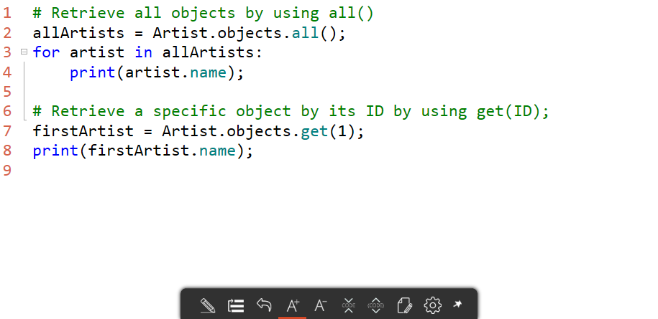
Basic queries

Slide 11
Basic queries
Notes:
Load all artists
In the shell, type:
allArtists = Artist.objects.all();
allArtists;
[<Artist: Artist object>] is displayed
The square brackets [ ] indicate a collection
allArtists[0].id;
The ID of the first artist is displayed
for artist in allArtists:
print(artist.name);
The Cure is displayed
Load an artist by ID
In the shell, type:
idArtist = Artist.objects.get(id = 1);
idArtist.name;
The Cure is displayed
Load an artist by its name (only one returned)
In the shell, type:
nameArtist = Artist.objects.get(name = 'The Cure');
nameArtist.name;
The Cure is displayed

Slide 12
Custom Queries

Slide 13
Custom queries
Django provides two main methods for writing queries
get
Returns one and only one object
If your query returns zero or more than one, an error is thrown
filter
Returns multiple objects
Technically a QuerySet, allowing for more complex queries

Slide 14
Basic filter syntax
Django is aware of your object structure, meaning you can query data using the class structure you created
Let's say you wanted to find an artist by its name:
Note: get works in our model because it would only return one artist
artist = Artist.objects.get(name = 'Artist Name');

Slide 15
How about starts with?
Often users want to write our a query where they only know part of the name, typically the beginning
To write this type of query, use property__startswith
artists = Artist.objects.filter(name__startswith = 'Great');
That's TWO underscores!

Slide 16
What about case sensitivity?
By default, queries are case sensitive
All operators are available with an insensitive variant
Simply put the letter i at the beginning
artists = Artist.objects.filter(name__istartswith = 'Great');

Slide 17
What about case sensitivity with an exact match?
Remember get?
Get is designed to only return one object
get always expects an exact match
The above query is the same as the one below
artist = Artist.objects.get(name = 'Artist Name');
artist = Artist.objects.get(name__exact = 'Artist Name');

Slide 18
So how do we make it case insensitive?
In order to make a query case insensitive, you need to use the explicit exact operator, and add the letter I
artist = Artist.objects.get(name__iexact = 'Artist Name');

Slide 19
Custom queries
Notes:
Load an artist by its name (only one returned)
In the shell, type:
nameArtist = Artist.objects.get(name = 'The Cure')
nameArtist.name
The Cure is displayed
Query artists by year (a collection is returned)
In the shell, type:
queryArtists = Artist.objects.filter(year_formed = 1978)
for artist in queryArtists:
print(artist.name)
The Cure is displayed

Slide 20
What happens if I want to load all albums by an artist?
Django allows you to walk the object chain using the foreign key relationship we defined
Create your filter by using object__property
Album
name
Artist
name
1
*
albums = Album.objects.filter(artist__name = 'Artist Name');

Slide 21
Walking the object chain

